Slide 1

LANBO
Advanced Equipment Solutions
Reliability Testing Equipment | Induction Heat Treatment Equipment
Environmental reliability
Thermal shock & corrosion
Induction hardening & brazing
Kunshan, Jiangsu, China

Slide 2
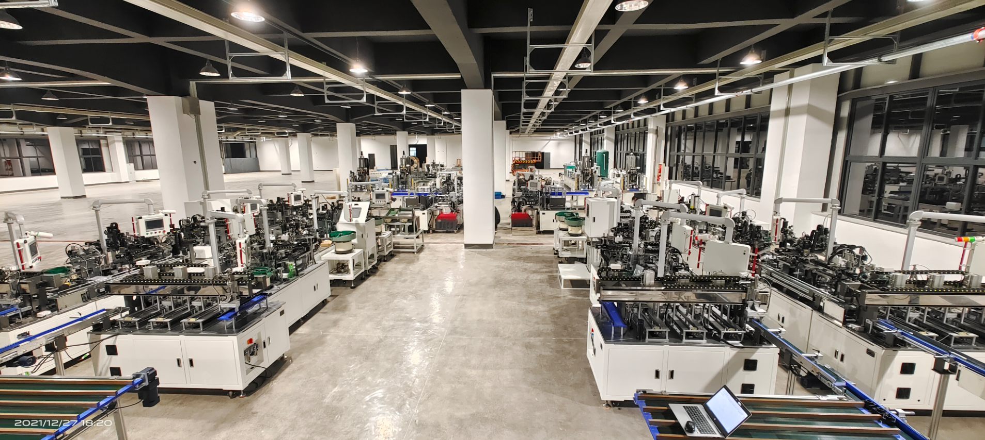
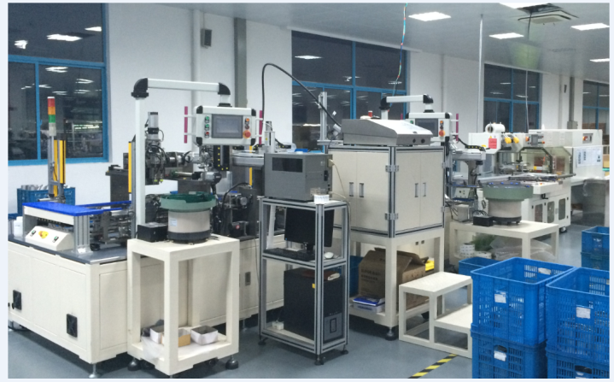
COMPANY POSITIONING
A focused equipment partner for validation, heating and intelligent manufacturing.
LANBO combines automated equipment engineering with specialized testing and induction-heating product lines.
2014
2005
23+
30+
Kunshan LANBO founded
Testing-equipment heritage
patents referenced
testing customers
High-tech equipment manufacturing base in Kunshan
LANBO ZTI reliability-testing specialization
Induction heating source deck cites patent portfolio
Environmental testing source deck cites broad customer base
Primary offer: reliability test equipment and induction heat treatment systems for industrial customers.
Supporting offer: vision inspection, assembly automation, warehousing and customized manufacturing systems.
LANBO Company Profile 2026
02

Slide 3
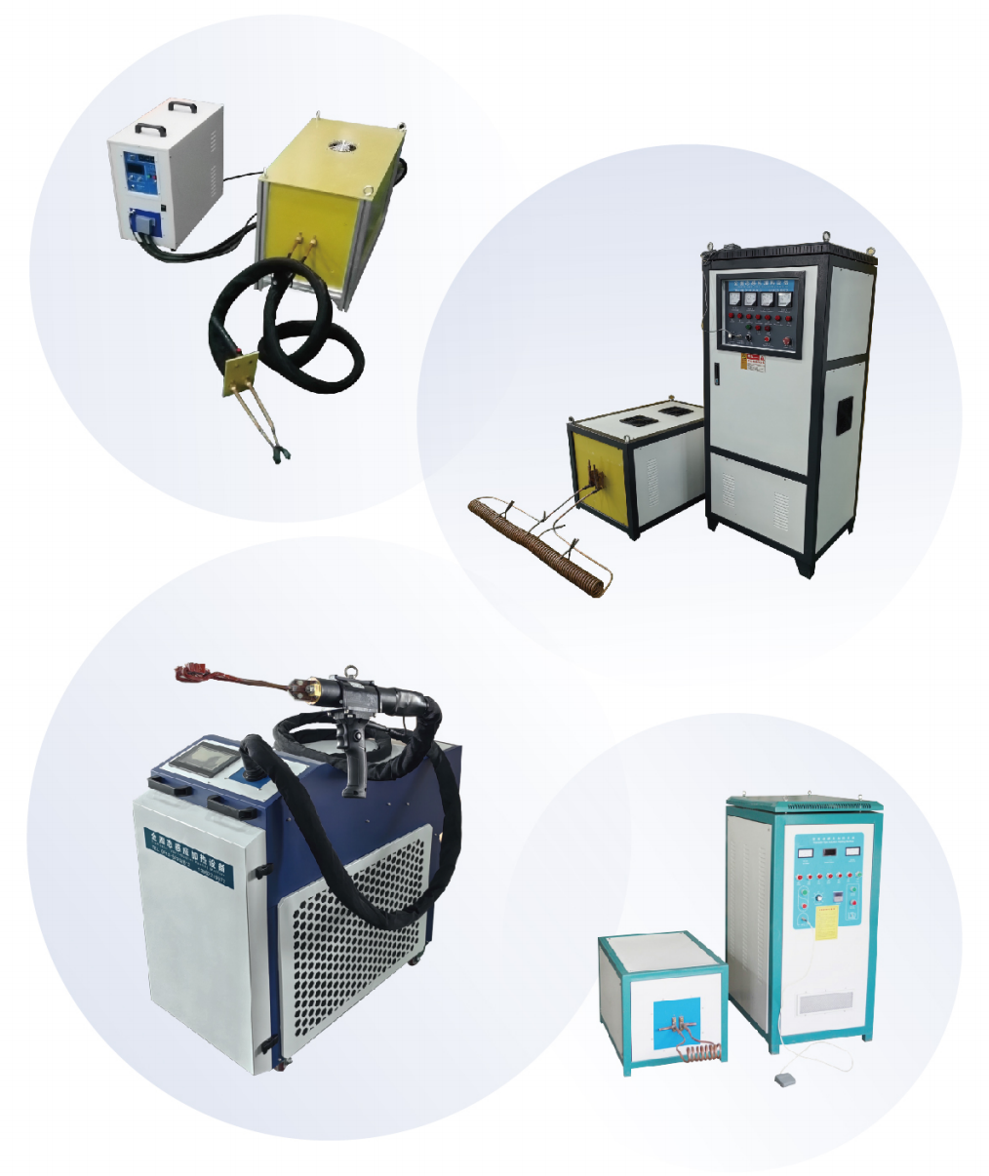
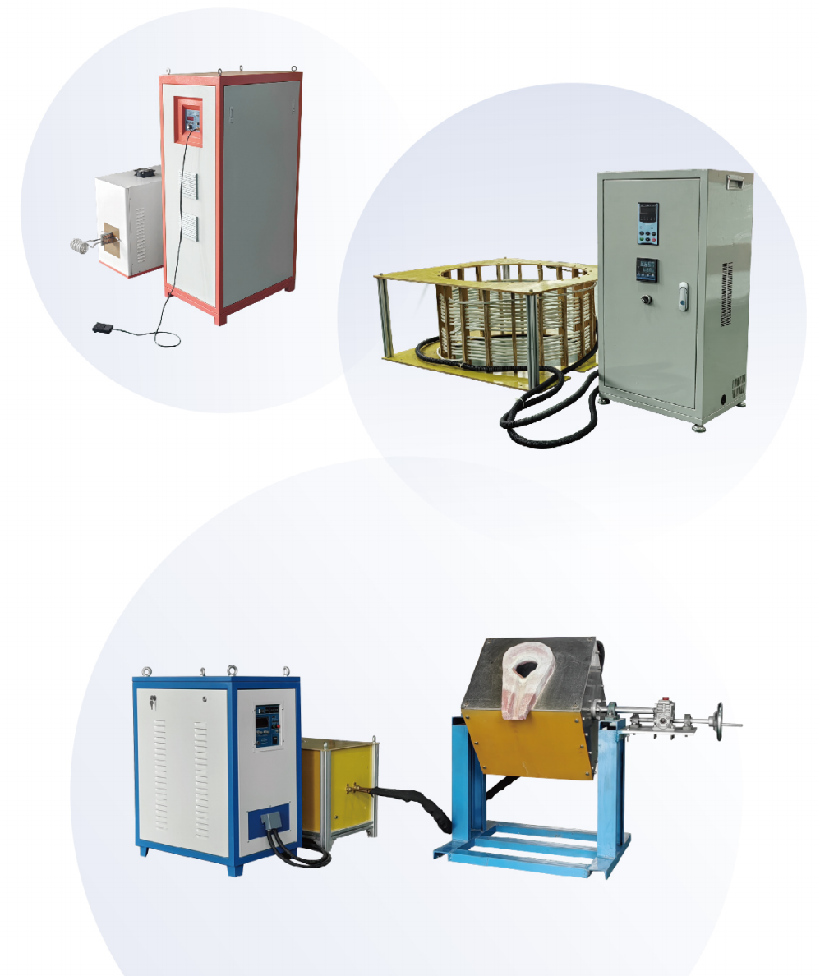
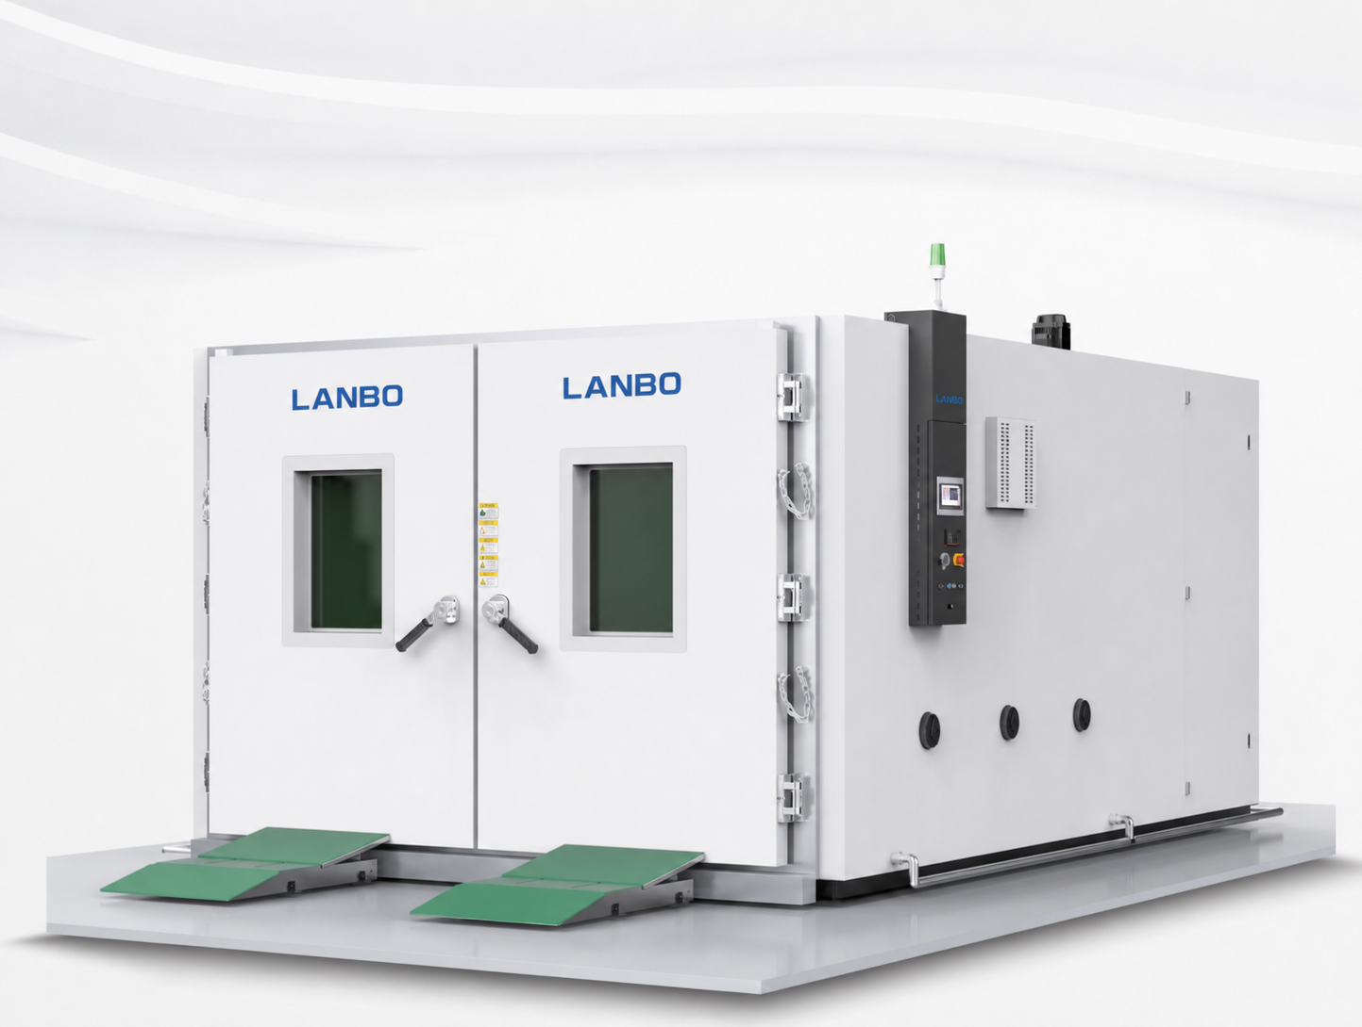
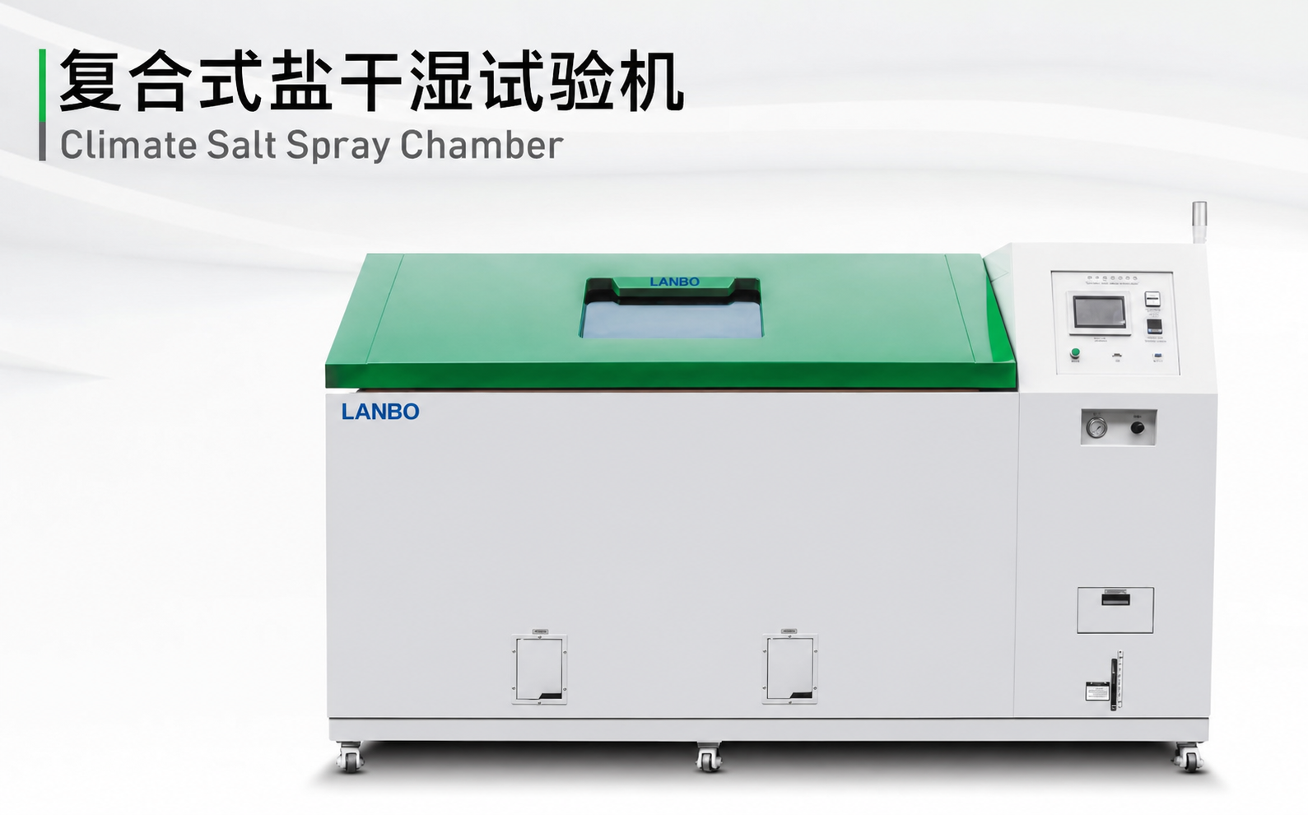
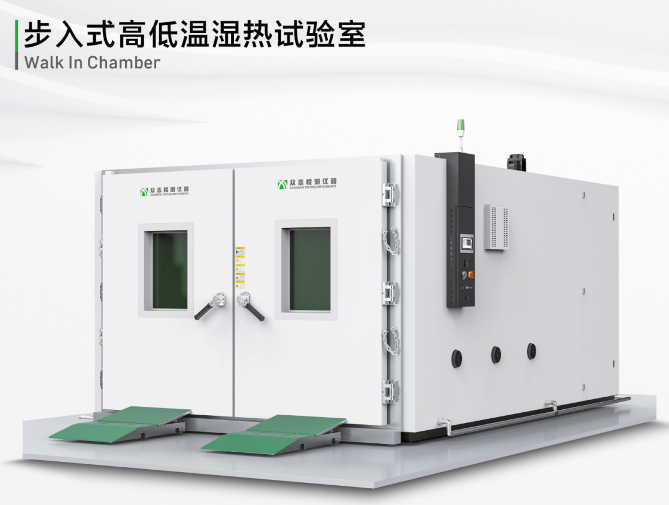
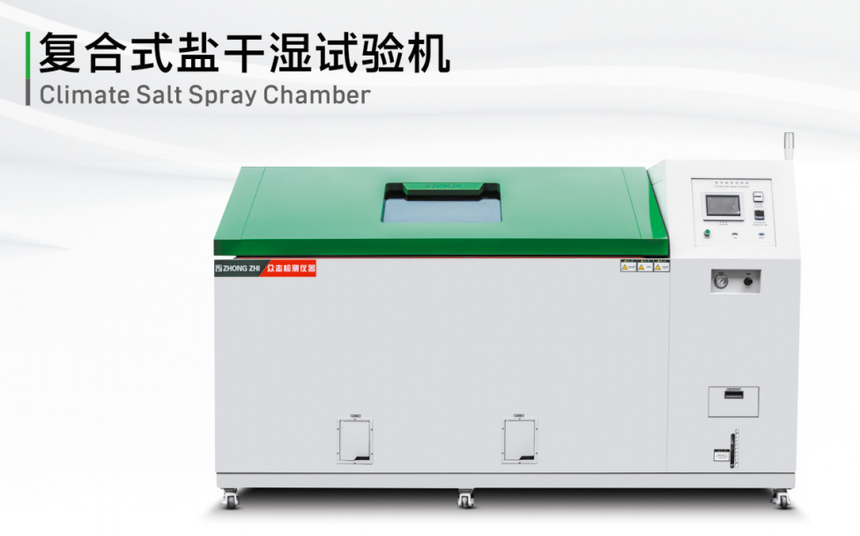
STRATEGIC FOCUS
Two equipment pillars carry the customer value story.
Other automation products are retained as supporting capabilities instead of competing for attention.
Reliability Testing Equipment
Induction Heat Treatment Equipment
Climate, thermal shock, humidity and altitude simulation
High, medium, ultra-high and super-audio frequency systems
Corrosion, aging, mechanical strength and fatigue tests
Surface hardening, brazing, melting, annealing and precision heating
Automotive, new energy, electronics and semiconductor validation
IGBT power units, customized coils and closed-loop cooling systems
LANBO Company Profile 2026
03

Slide 4
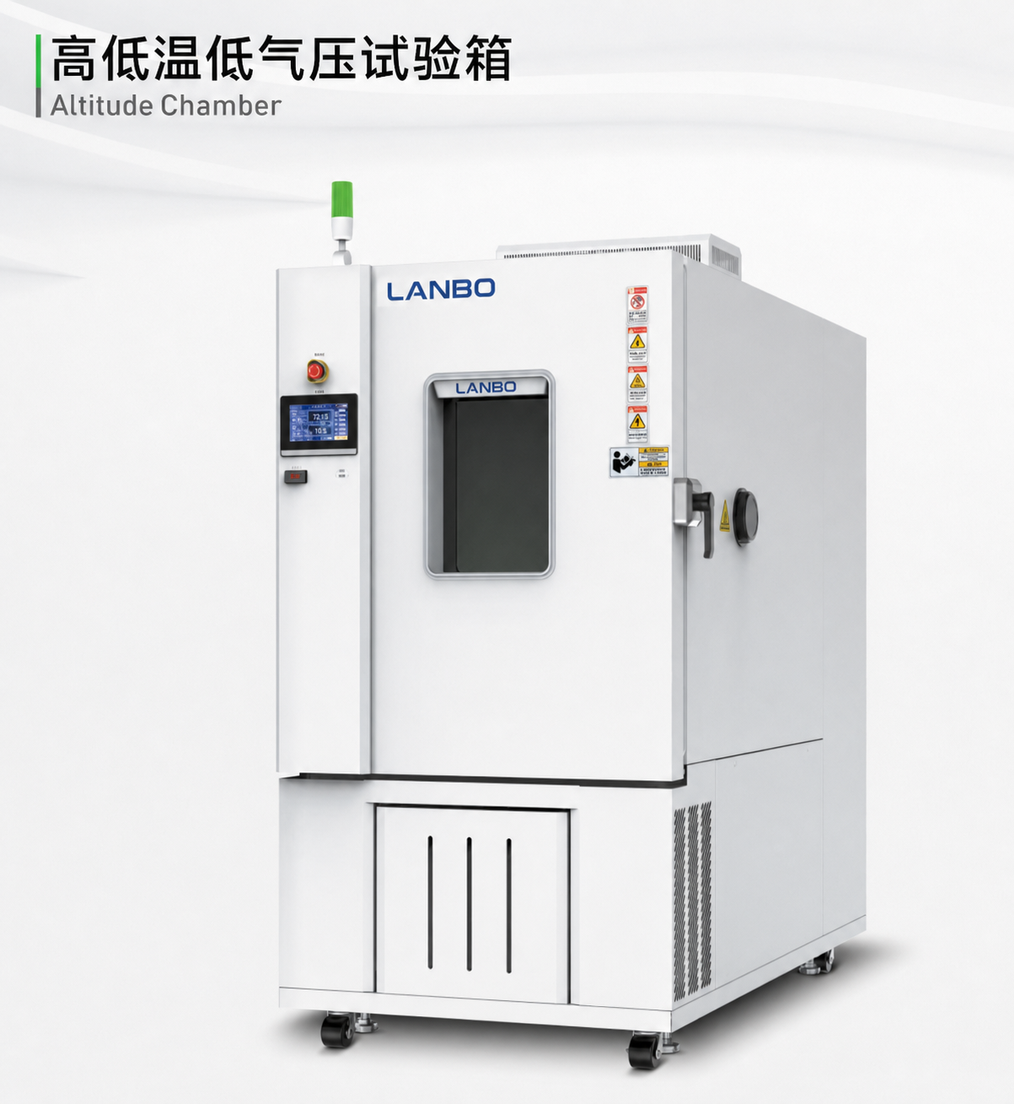
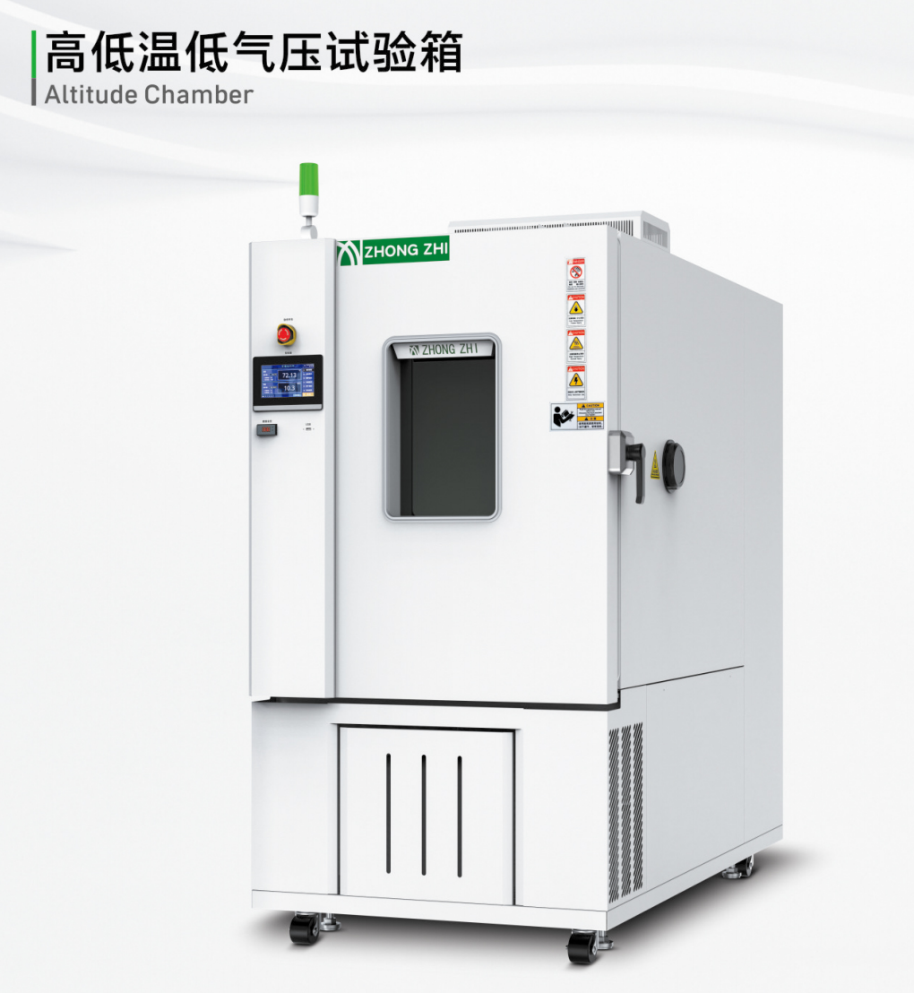
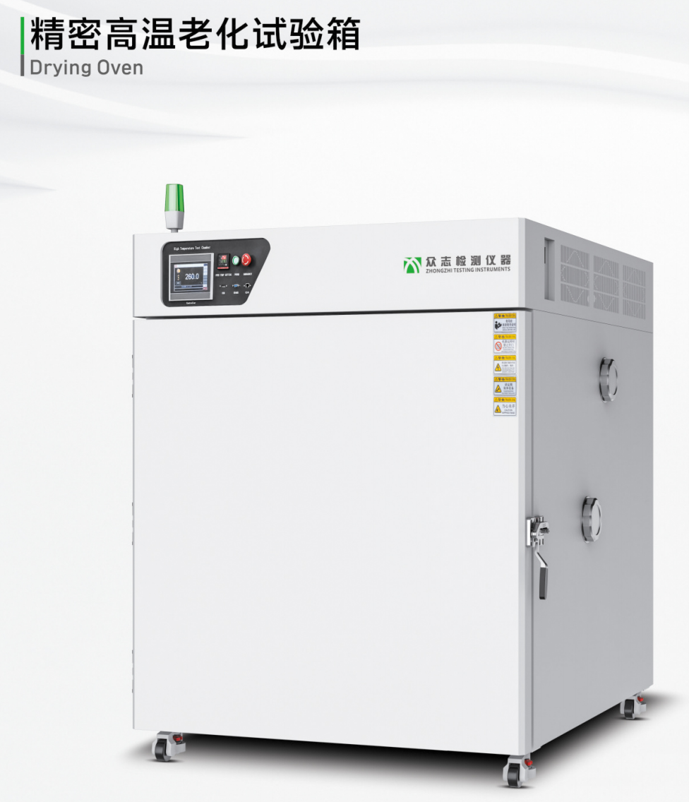
RELIABILITY TESTING
A broad chamber portfolio covers the main environmental stress modes.
The product range supports accelerated validation from component-level samples to large assemblies and vehicles.
Climate Chambers
Thermal Shock
Walk-In Testing
Corrosion & Aging
High/low temperature, humidity, rapid temperature change, altitude and double-layer chambers.
Two-zone and three-zone shock chambers for fast durability screening.
Large climate rooms for vehicles, battery packs, equipment and oversized parts.
Salt spray, composite salt spray, SO2, mold and corrosive gas simulation.
LANBO Company Profile 2026
04
LANBO Europe ready

Slide 5
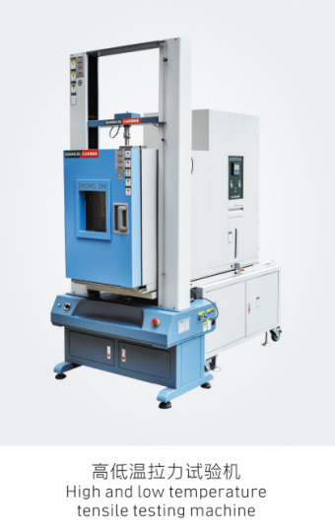
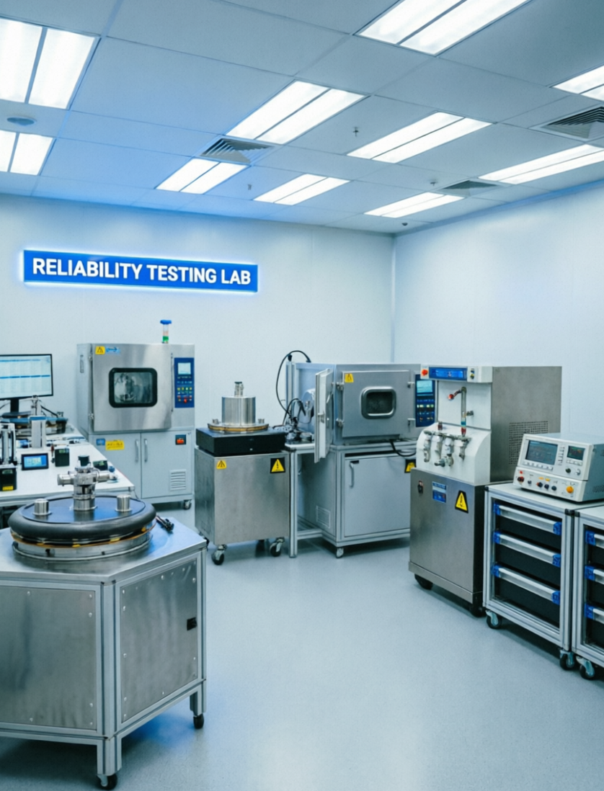
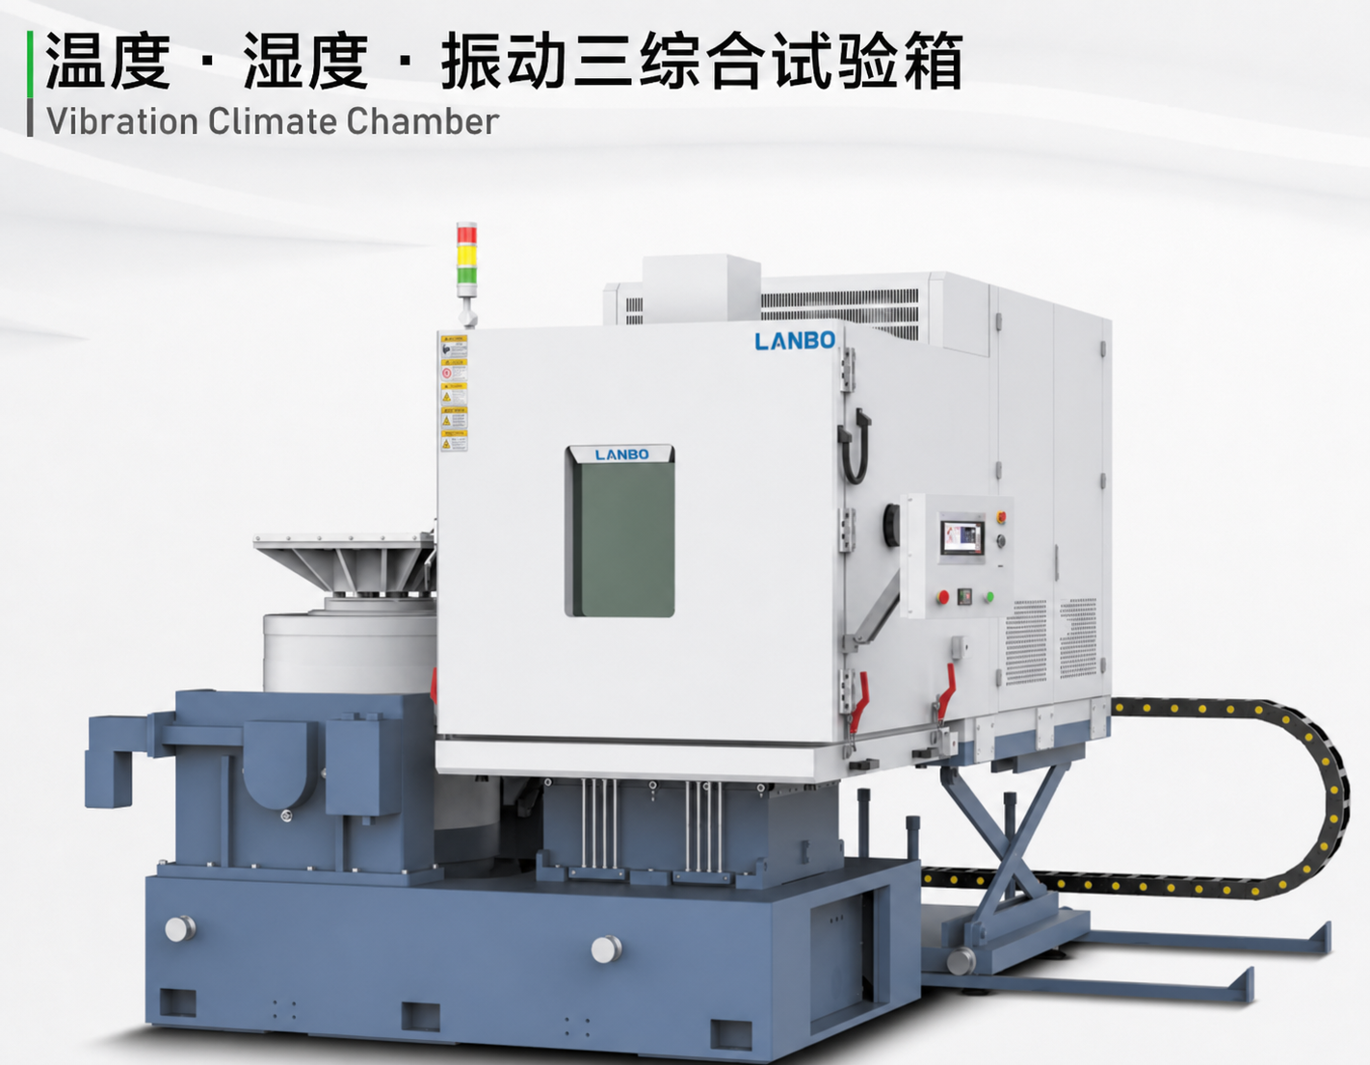
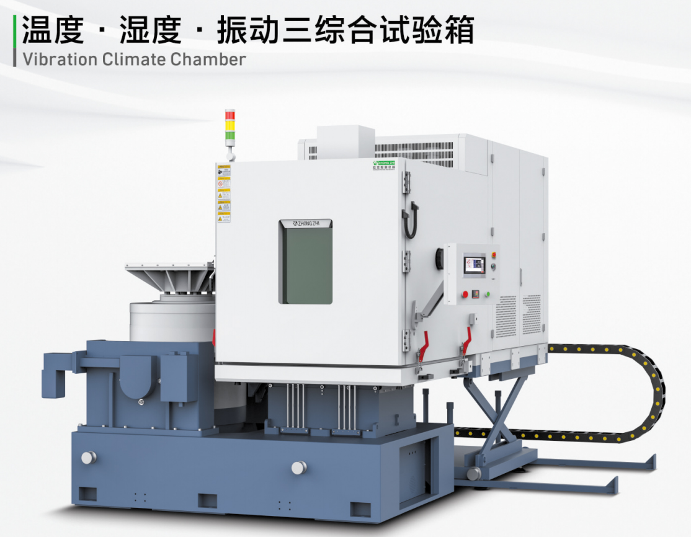
VALIDATION WORKFLOW
Reliability equipment helps customers move from stress simulation to release confidence.
The strongest value is not only chamber hardware, but repeatable validation programs for complex products.
01
02
03
04
Define Stress
Select Equipment
Run Program
Release Decision
Temperature, humidity, altitude, corrosion, vibration or mechanical load
Chamber type, test volume, transition speed, control accuracy and safety features
Automated cycles, data logging and specimen monitoring
Durability evidence for automotive, energy, electronics and industrial products
Supports battery packs, cells, modules, semiconductor processes, electronics and complete vehicle simulation cabins.
LANBO Company Profile 2026
05
LANBO Europe ready

Slide 6
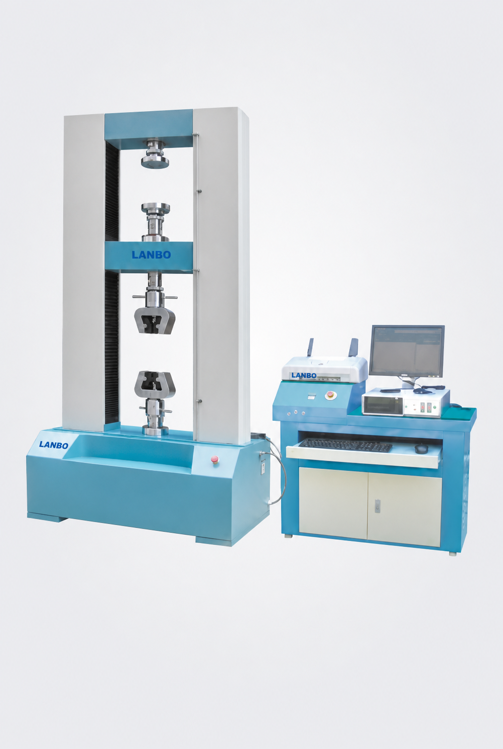
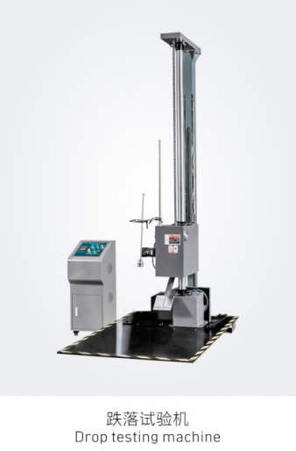
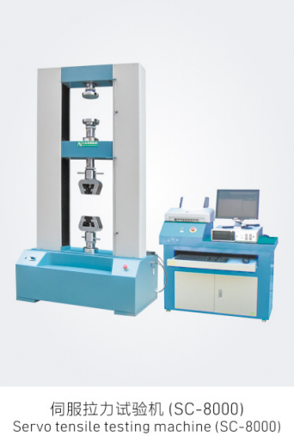
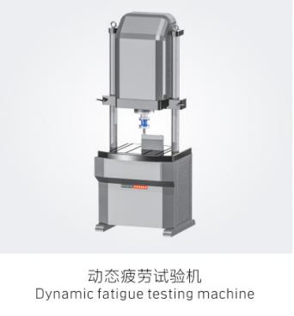
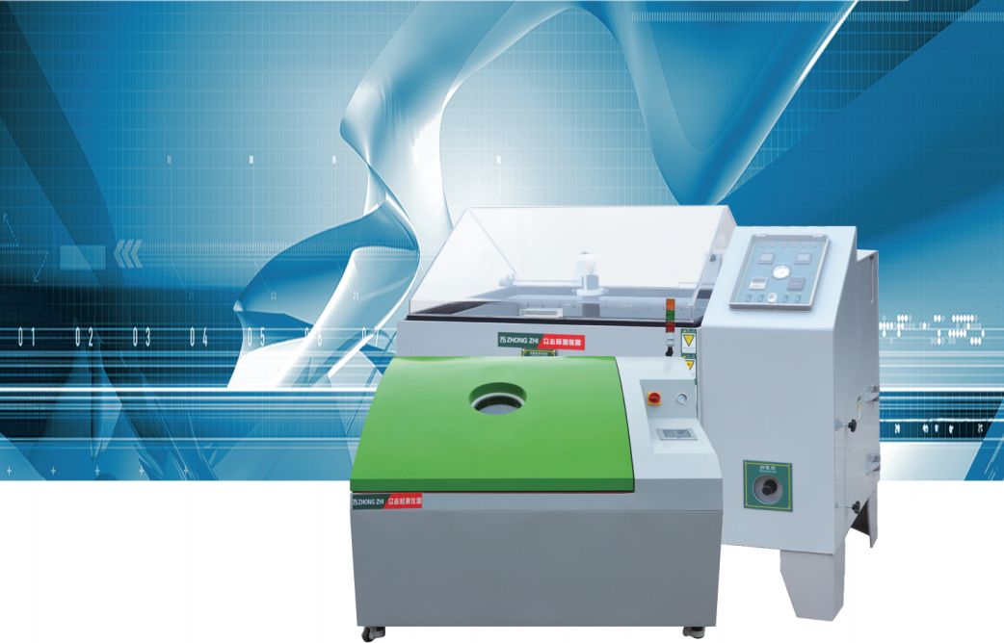
EXTENDED TEST SCOPE
Mechanical, corrosion and aging tests complete the reliability picture.
Customers can combine environmental stress with material strength and logistics durability checks.
Mechanical Testing
Corrosion & Aging
Servo tensile testing
Salt spray and composite salt spray
High/low temperature tensile testing
Corrosive gas, SO2 and mold simulation
Drop testing and dynamic fatigue
Long-term material resilience evaluation
LANBO Company Profile 2026
06
LANBO Europe ready

Slide 7

INDUCTION HEAT TREATMENT
Non-contact electromagnetic heating enables fast, clean and controllable thermal processing.
LANBO systems convert 50/60Hz mains power into high-frequency alternating current. A water-cooled copper coil generates a changing magnetic field, inducing eddy-current heating inside the workpiece.
Typical benefits: rapid heating, localized heat input, lower emissions and high process repeatability.
IGBT Power Unit
Customized Coil
Cooling System
Stable high-frequency power conversion
Heating profile matched to part geometry
Continuous operation and coil protection
LANBO Company Profile 2026
07
LANBO Europe ready

Slide 8
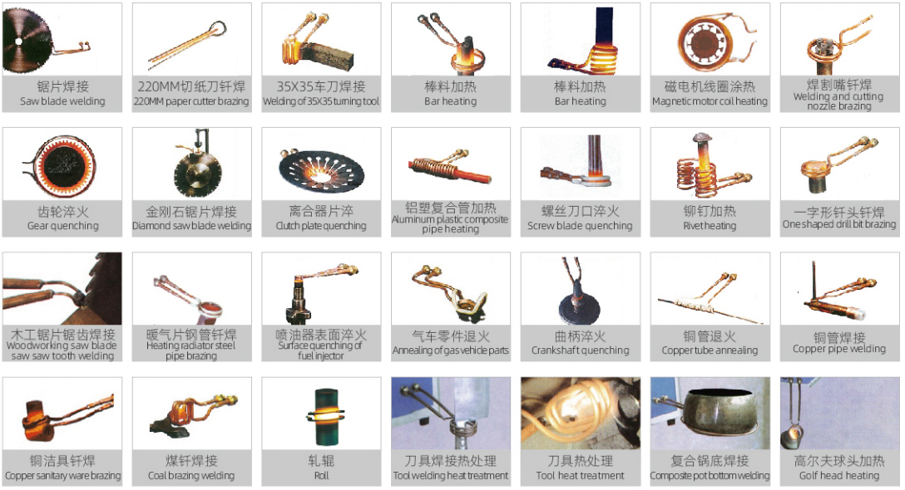
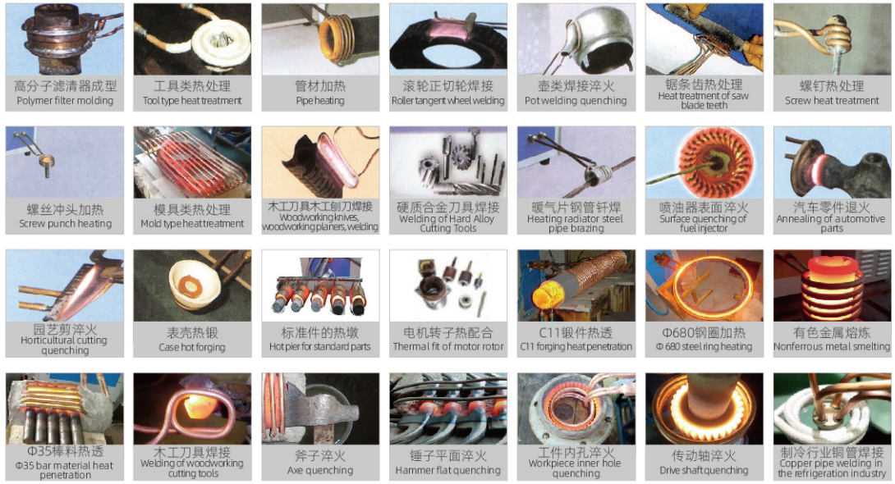
INDUSTRIAL APPLICATIONS
Induction heating equipment supports hardening, brazing, melting and precision thermal processes.
The application scope spans automotive, tooling, machinery, electronics and metal component manufacturing.
Surface hardening
Brazing and welding
Annealing
Hot fitting
Melting
Localized precision heating
LANBO Company Profile 2026
08
LANBO Europe ready

Slide 9
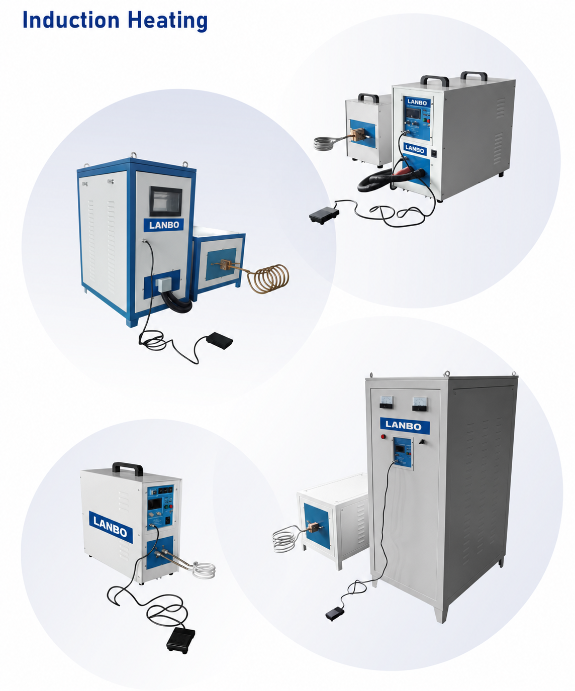
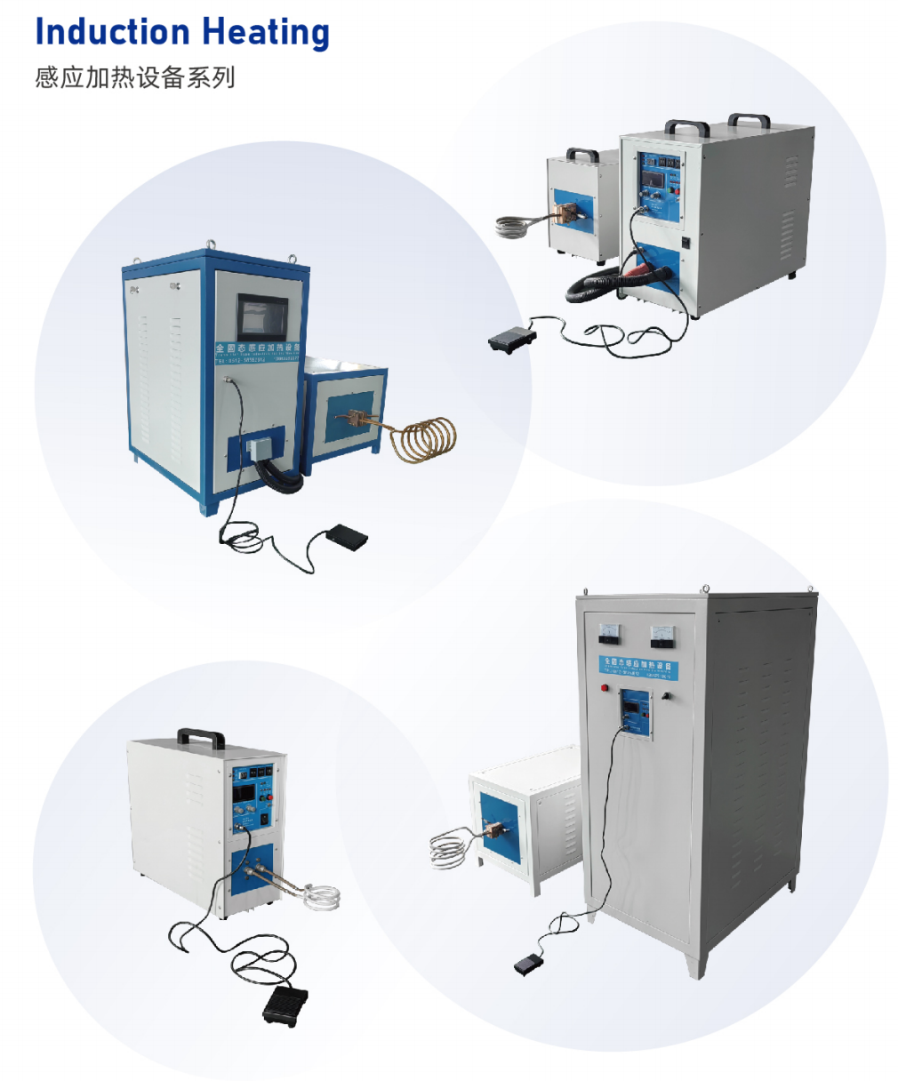
EQUIPMENT SERIES
Frequency and power options are matched to heating depth, speed and part geometry.
The portfolio covers compact precision heating through high-power deep penetration and melting applications.
Series
Power
Frequency
Best-fit use
High Frequency
15-260KVA
30-100KHz
Surface hardening, brazing, compact units
Medium Frequency
35-600KVA
5-30KHz
Deep penetration, melting and stronger magnetic field
Ultra High Frequency
6-200KVA
100-1500KHz
Micron-level thin-layer and precision heating
Super Audio
35-600KVA
10-30KHz
Balanced depth and speed for industrial parts
LANBO Company Profile 2026
09
LANBO Europe ready

Slide 10
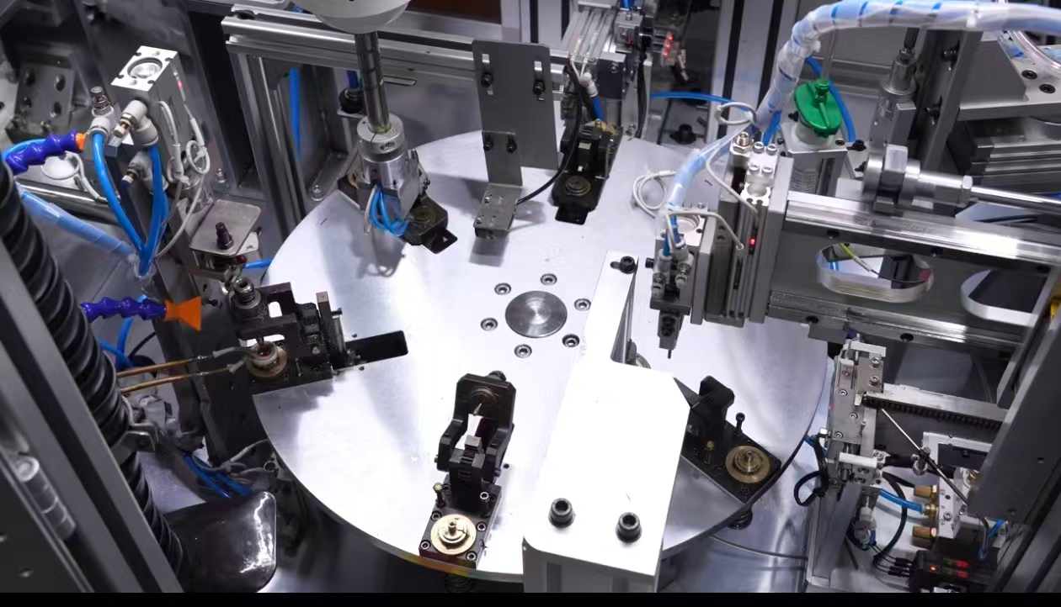
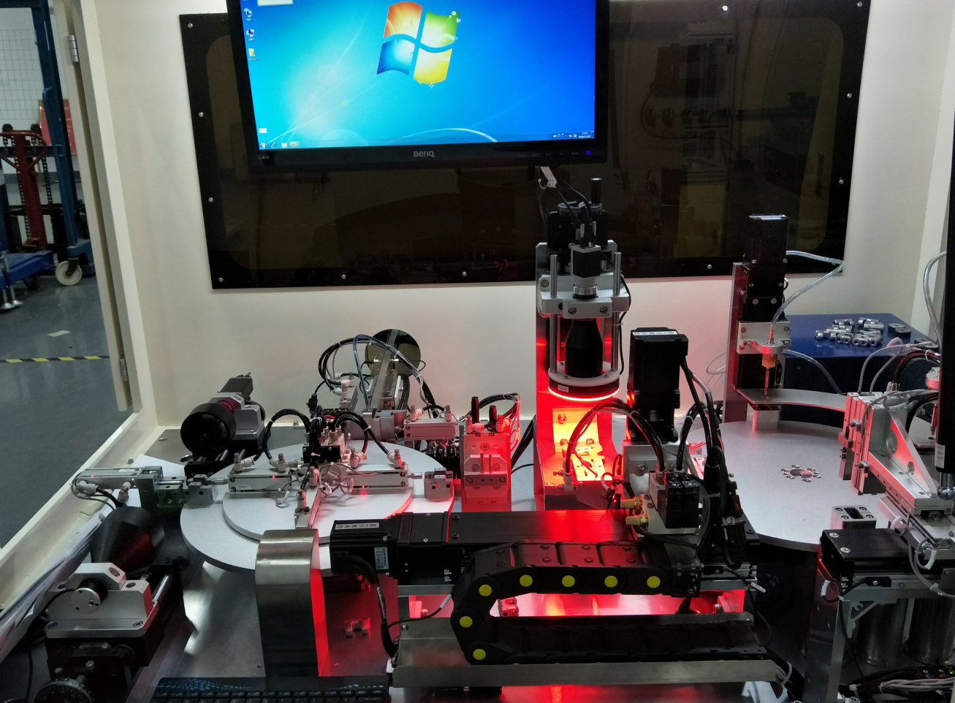
INDUSTRY FIT
The same engineering base serves product validation, thermal processing and production automation.
This makes LANBO useful when customers need both equipment supply and process integration.
Automotive & EV
Electronics & Semiconductor
Vehicle parts, battery packs, air-conditioning connectors, thermal management and full simulation cabins.
Environmental reliability, curing-process support, chip assembly, connector automation and precision inspection.
Industrial Components
Factory Automation
Induction hardening, brazing, metal heating, pneumatic components and mechanical durability testing.
Vision guidance, robotic handling, automated assembly, online inspection and smart warehousing.
LANBO Company Profile 2026
10

Slide 11
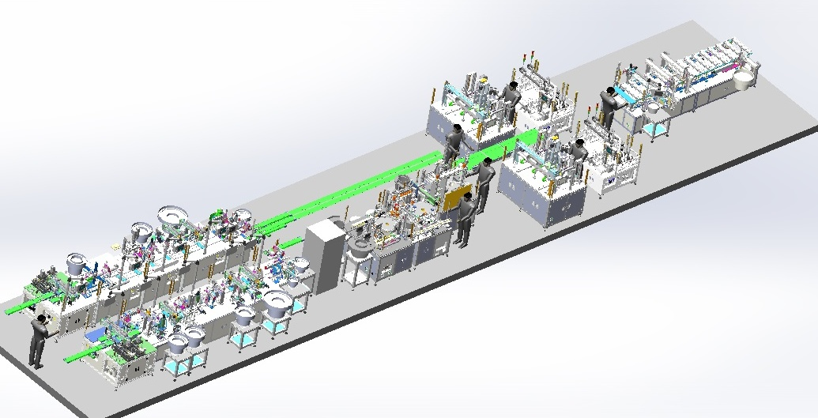
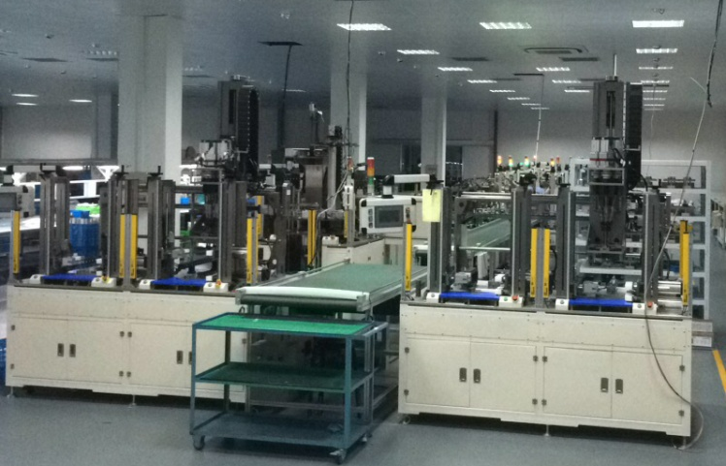
ASSEMBLY AUTOMATION
Customized assembly lines improve throughput, consistency and labor efficiency.
This category is positioned as a supporting capability for customers who need turnkey equipment around production flow.
Standard cylinder assembly and testing lines, including locking, air-tightness testing, labeling and accessory assembly.
Solenoid valve terminal wire assembly, connector laser welding/loading and unloading, MDP and Mini DisplayPort assembly.
LANBO Company Profile 2026
11
LANBO Europe ready

Slide 12
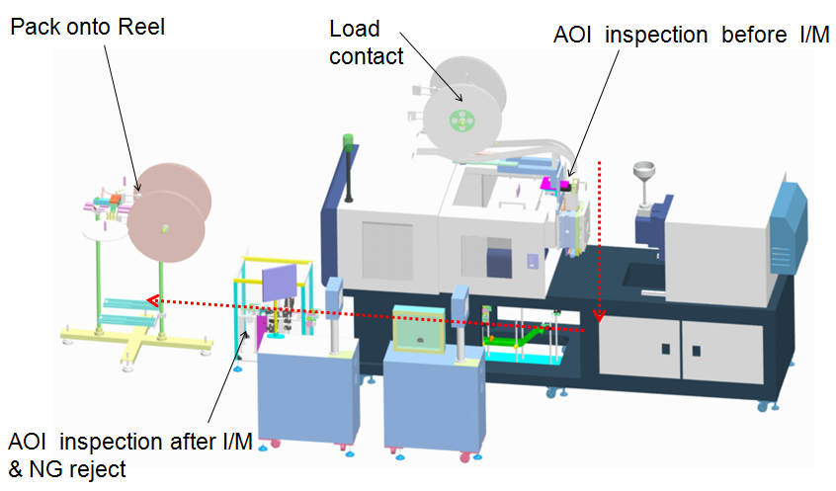
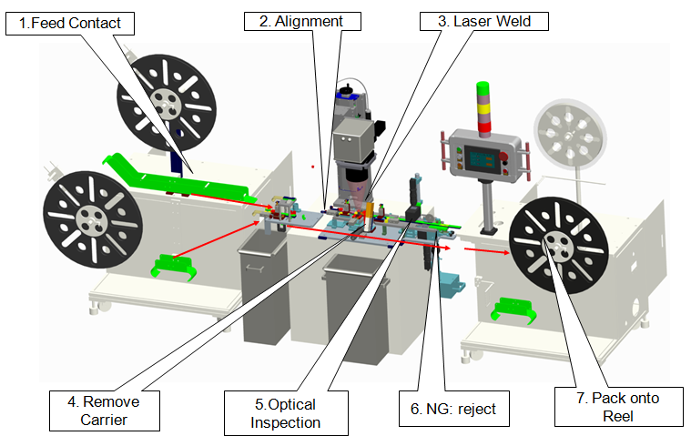
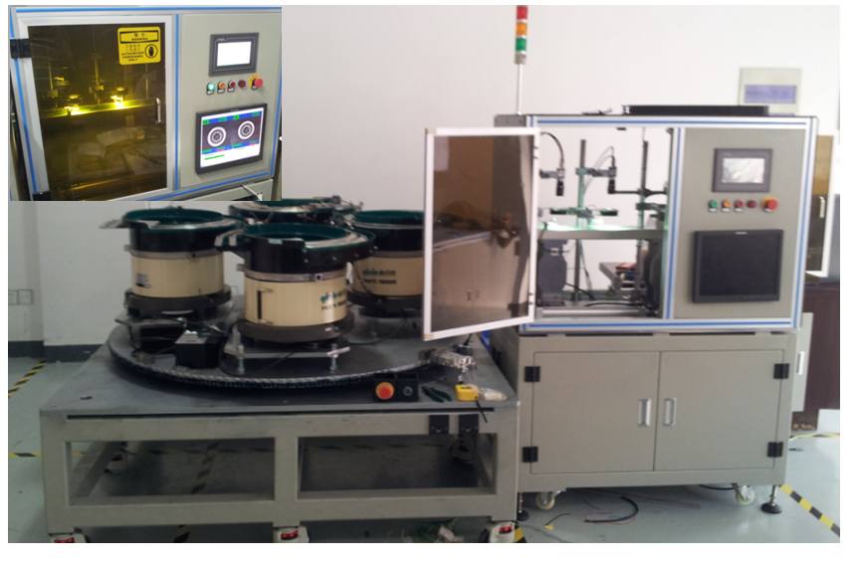
VISION & PRECISION MEASUREMENT
Inline inspection systems detect dimensions, appearance and positioning errors at production speed.
LANBO integrates CCD vision, 3D line scanning, pneumatic gauging and high-speed sorting according to the product geometry.
3D guided assembly
Connector inspection
High-speed sorting
Line-scan camera positioning for large automotive accessories.
Automatic feeding, dual CCD dimensional checks and pneumatic inner-hole detection.
Appearance and dimension checks for small hardware and plastic parts.
LANBO Company Profile 2026
12
LANBO Europe ready

Slide 13
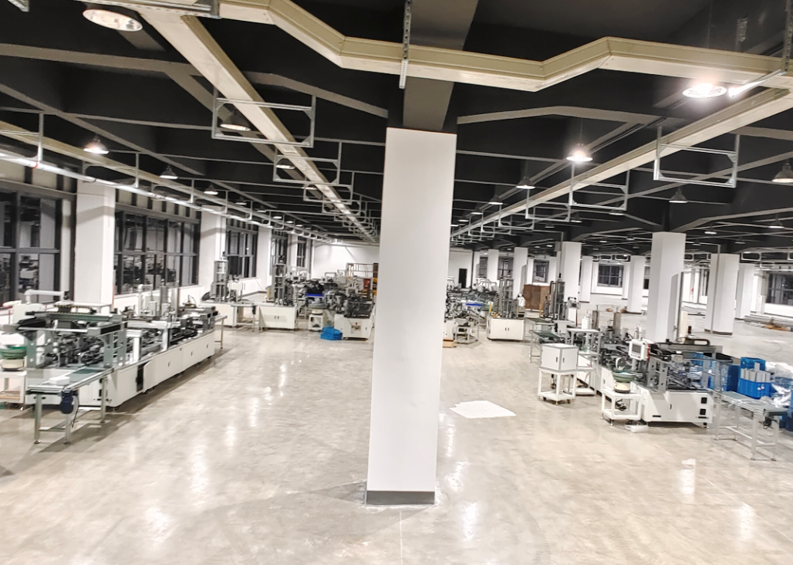
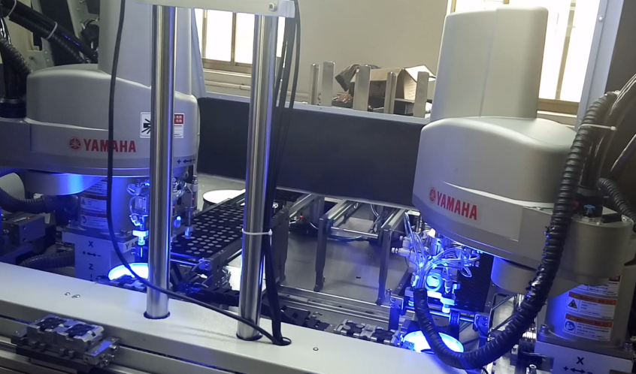
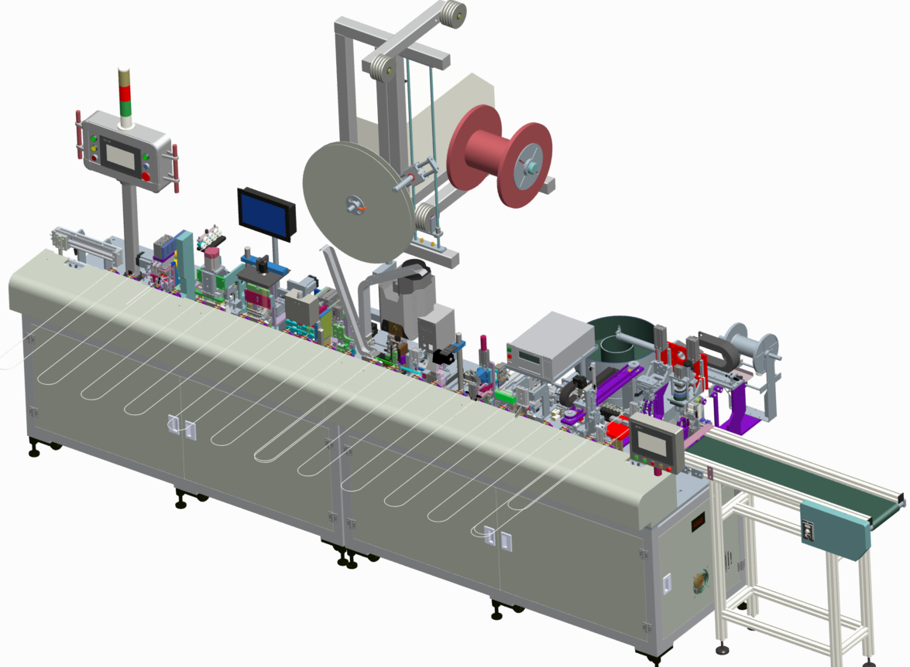
WELDING & PROCESS AUTOMATION
Special-process equipment links heating, welding, drying and handling into automated cells.
These solutions are used where the process requires stable cycle time, repeatable positioning and reduced manual handling.
Typical equipment
Process value
High-frequency welding machine for tungsten carbide burrs
Unmanned loading and unloading
Thread glue spraying and drying line for air pipe joints
Stable welding, drying and transfer flow
LANBO Company Profile 2026
13
LANBO Europe ready

Slide 14
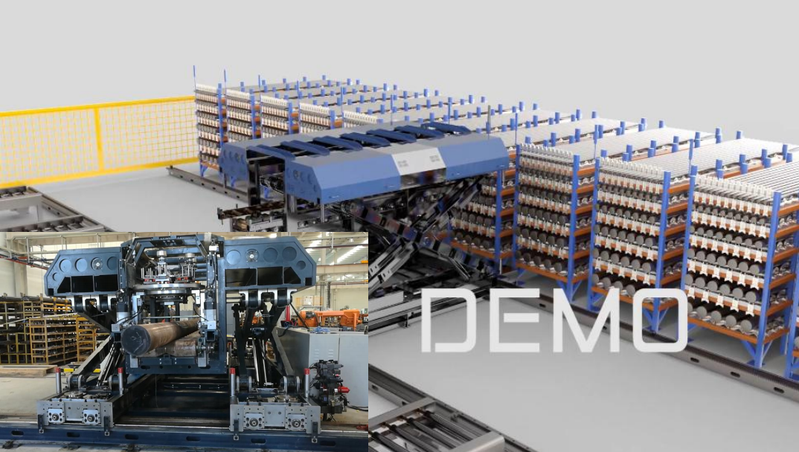
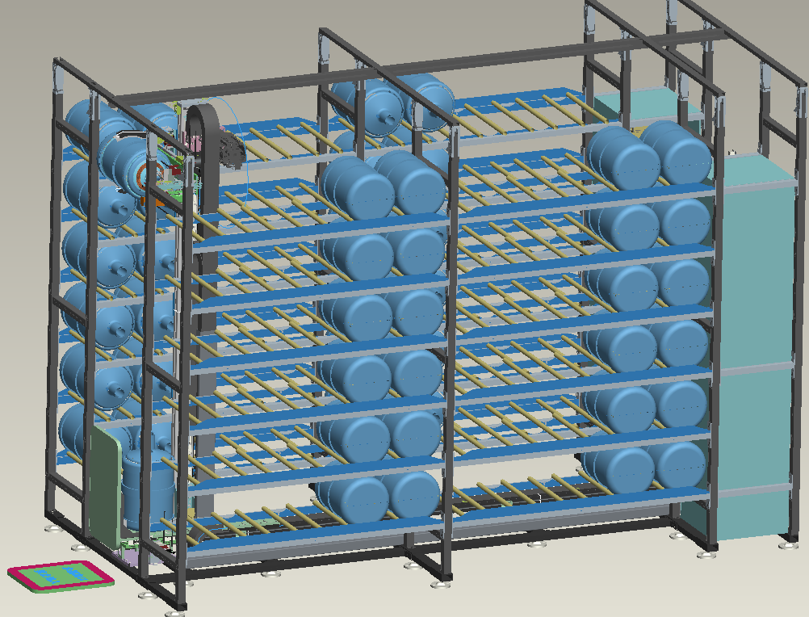
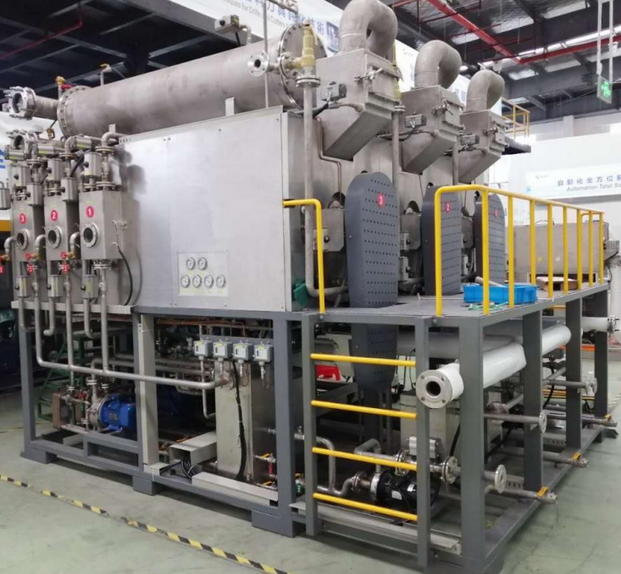
SMART LOGISTICS & WAREHOUSING
Automated handling systems connect equipment lines with warehouse and production planning data.
LANBO's special warehousing projects support heavy bars, plates and packaged goods with identification, handling and database integration.
Identify
Grab & Move
Convey
MES / ERP Link
LANBO Company Profile 2026
14
LANBO Europe ready

Slide 15
ENVIRONMENTAL TREATMENT SYSTEMS
Wastewater and waste-liquid treatment equipment extends LANBO's special equipment capability.
This product category is summarized for completeness and can be expanded only when it is relevant to the customer's project.
Typical treatment scope
Electroplating wastewater containing gold, silver, copper, nickel and other metals
Phosphoric-acid wastewater, cutting fluids, grinding liquid and paint waste liquid
Fluorine-acid wastewater, ammonium sulfate waste liquid and saline wastewater
Positioning: a supporting category for customers seeking customized process equipment and integrated factory solutions.
LANBO Company Profile 2026
15
LANBO Europe ready

Slide 16

CONTACT
Let us match the equipment to your test, heating or production process.
Kunshan LANBO Electric Appliance Co., Ltd.
No. 1288 Chengbei Middle Road, Yushan Town, Kunshan City, Jiangsu Province, China
Business phone: +86 139 6269 5020
Email: hase.huang@lanbo-europe.com
European contact: Gavin Ye | +36 202 272 276 | sales@lanbo-europe.com
Reliability testing
Induction heat treatment
Custom automation

